Slide 1

Developing Business
Blockchain Applications
on Hyperledger
May 2018
Dr.Thanachart Numnonda
IMC Institute
thanachart@imcinstitute.com
Notes:
11/4/16
‹#›
‹#›

Slide 2
Launch an Ubuntu virtual server
Using Google Cloud Platform
(You can skip this part if you already have an Ubuntu server)
Notes:
11/4/16
‹#›
‹#›

Slide 3
Launch Google Cloud Virtual Server
In this lab, we will use a GCP’s compute engine as our server with the following specification:
Ubuntu Server 14.04 LTS
2 vCPU, 7.5 GB memory
50 GB SSD
Notes:
11/4/16
‹#›
‹#›

Slide 4
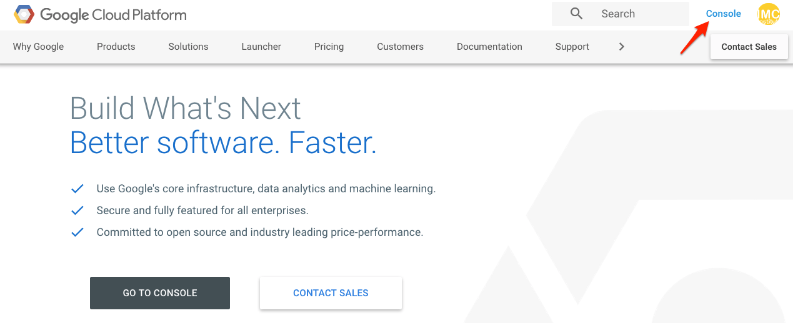
cloud.google.com
Notes:
11/4/16
‹#›
‹#›

Slide 5
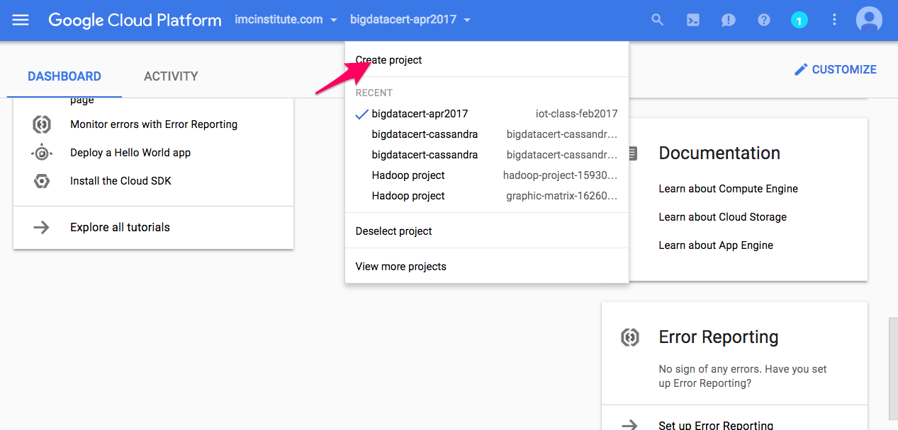
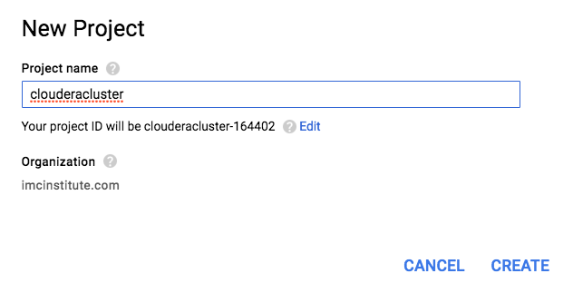
Create Google Cloud Project
Notes:
11/4/16
‹#›
‹#›

Slide 6
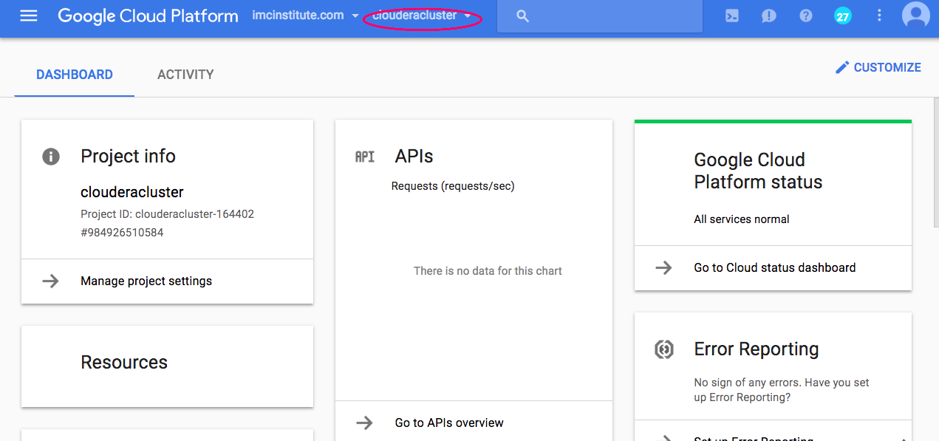

Slide 7
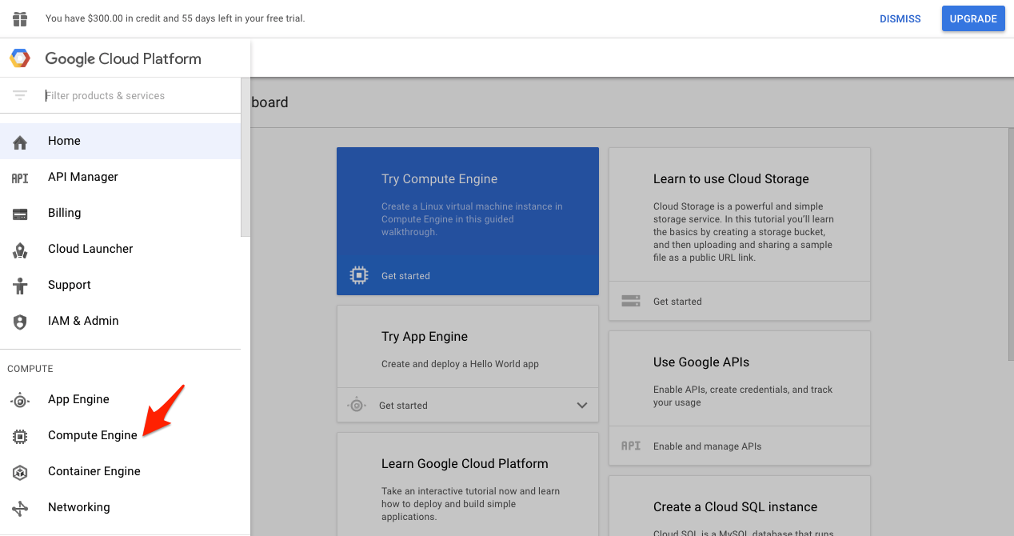
Select Compute Engine
Notes:
11/4/16
‹#›
‹#›

Slide 8
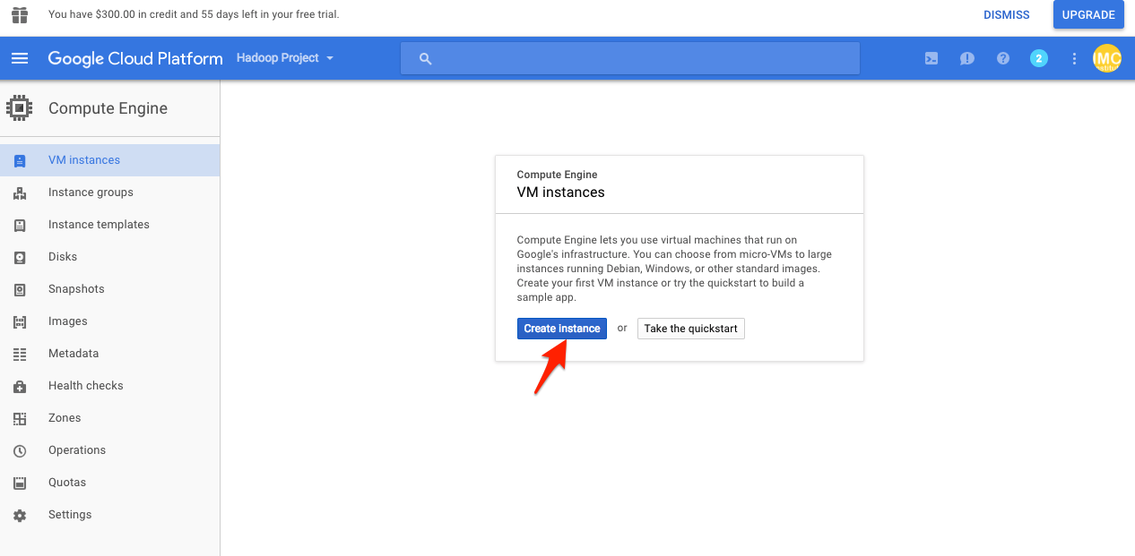
Select Create Instance
Notes:
11/4/16
‹#›
‹#›

Slide 9
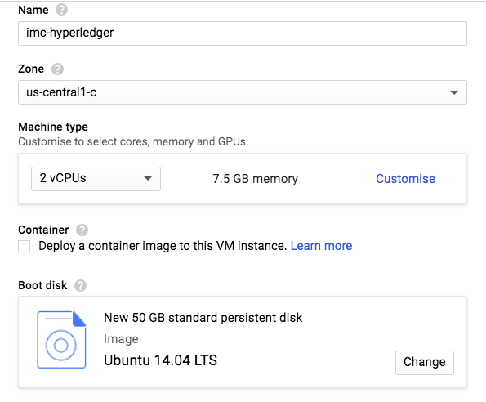
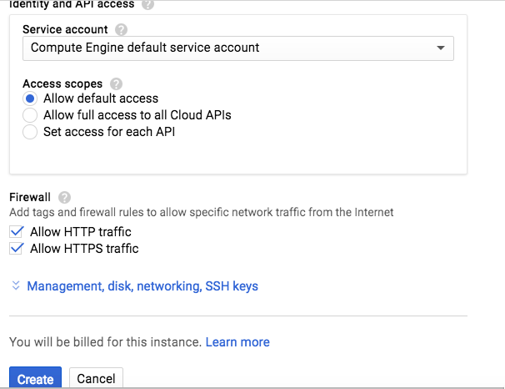
Create an instance with the following configuration
Notes:
11/4/16
‹#›
‹#›

Slide 10
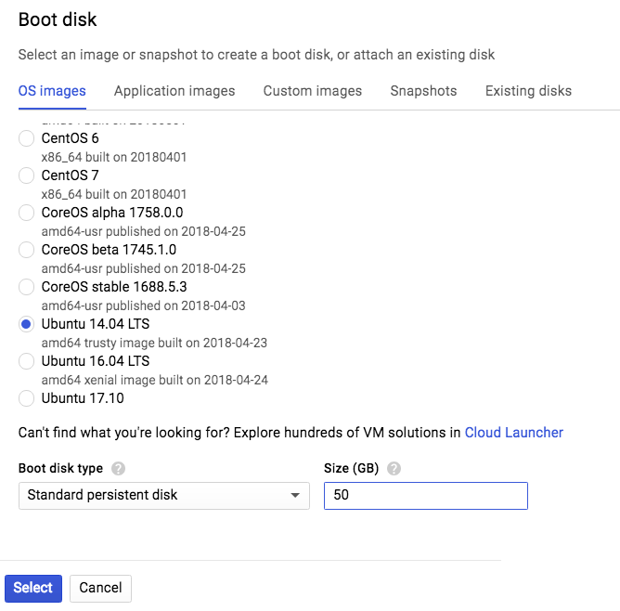
Select boot disk as Ubuntu 14.04 and 50 GB
Notes:
11/4/16
‹#›
‹#›

Slide 11
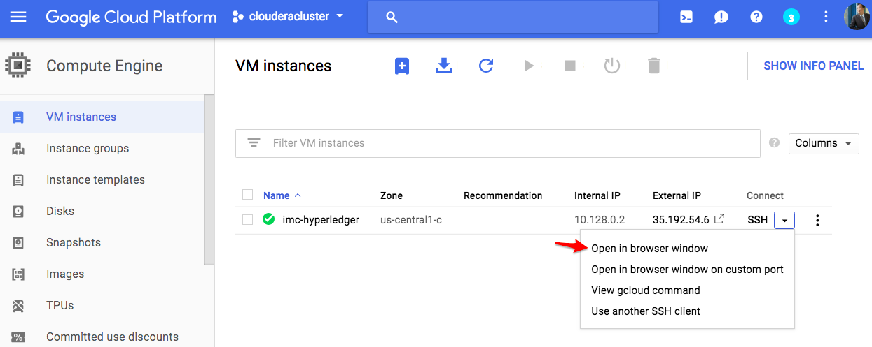
Connect via SSH in browser window
Notes:
11/4/16
‹#›
‹#›

Slide 12
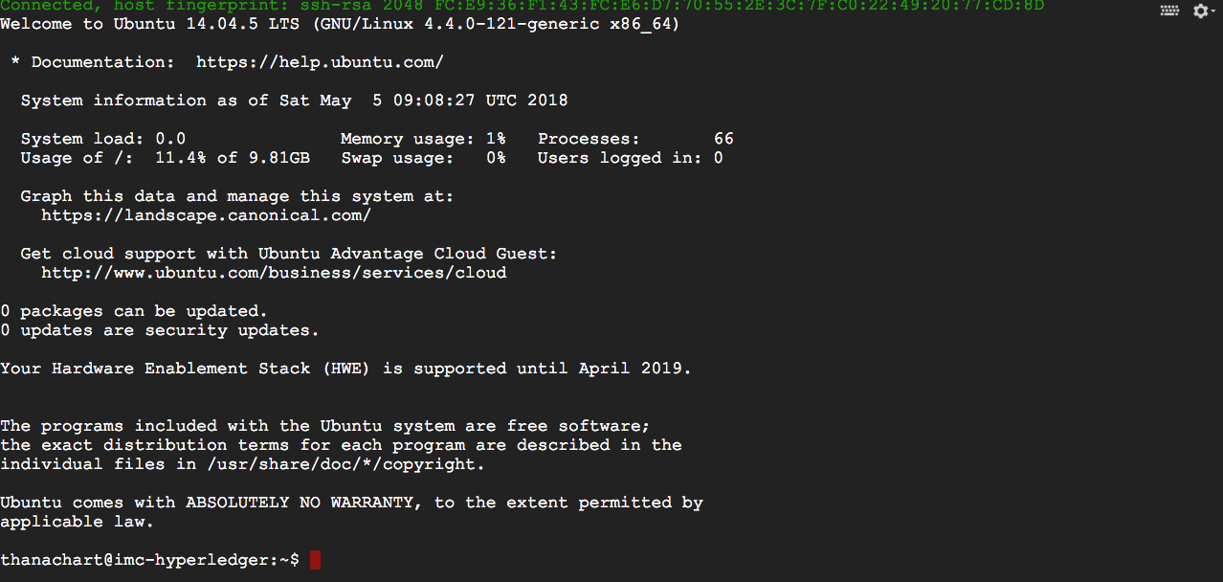
Connect to the instance
Notes:
11/4/16
‹#›
‹#›

Slide 13
Installing Hyperledger
development environment
Notes:
11/4/16
‹#›
‹#›

Slide 14
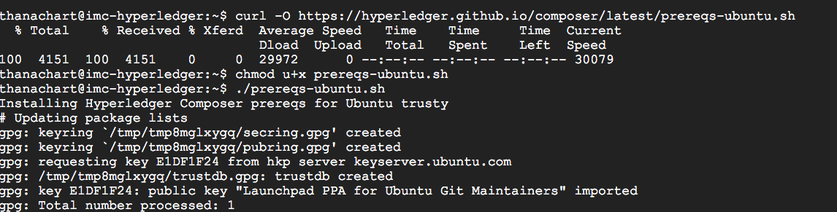
Installing prerequisites
$ curl -O https://hyperledger.github.io/composer/latest/prereqs-ubuntu.sh
$ chmod u+x prereqs-ubuntu.sh
$ ./prereqs-ubuntu.sh
Logout then login before continuing
Notes:
11/4/16
‹#›
‹#›

Slide 15
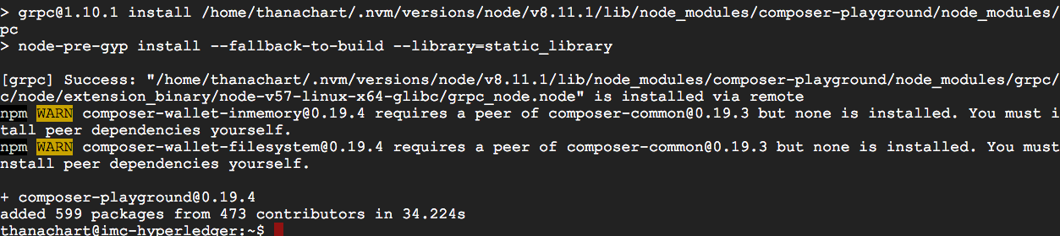
Installing the Hyperledger Composer tools
$ npm install -g composer-cli
$ npm install -g composer-rest-server
$ npm install -g generator-hyperledger-composer
$ npm install -g yo
$ npm install -g composer-playground
Notes:
11/4/16
‹#›
‹#›

Slide 16
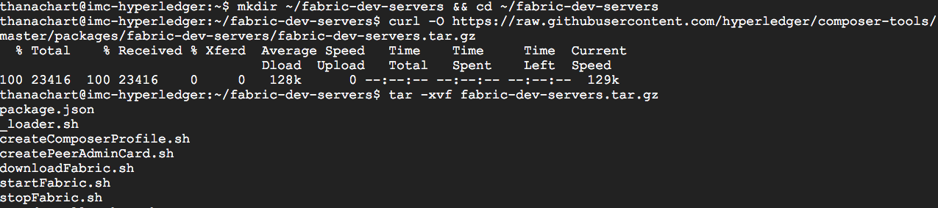
Installing Hyperledger Fabric
$ mkdir ~/fabric-dev-servers && cd ~/fabric-dev-servers
$ curl -O https://raw.githubusercontent.com/hyperledger/composer-
tools/master/packages/fabric-dev-servers/fabric-dev-servers.tar.gz
$ tar -xvf fabric-dev-servers.tar.gz
$ ./downloadFabric.sh
Notes:
11/4/16
‹#›
‹#›

Slide 17
Starting Hyperledger-Fabric
&
Hyperledger composer playground
Notes:
11/4/16
‹#›
‹#›

Slide 18
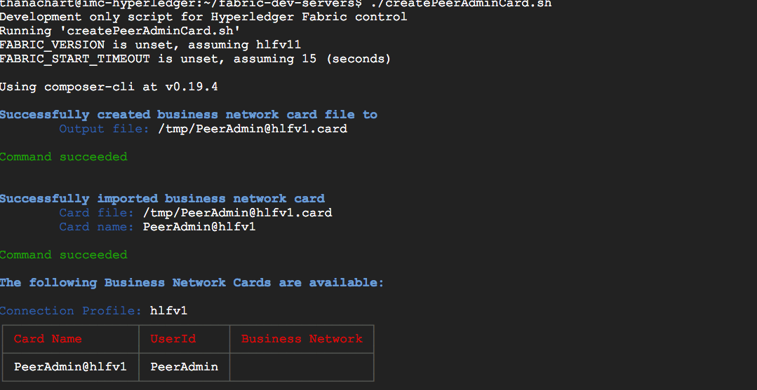
Starting Hyperledger-Fabric
$ ./startFabric.sh
$ ./createPeerAdminCard.sh
Notes:
11/4/16
‹#›
‹#›

Slide 19
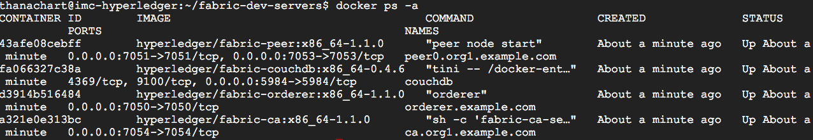
Viewing running process
$ docker ps -a
Notes:
11/4/16
‹#›
‹#›

Slide 20
Starting composer-playground
$ composer-playground
Notes:
11/4/16
‹#›
‹#›

Slide 21
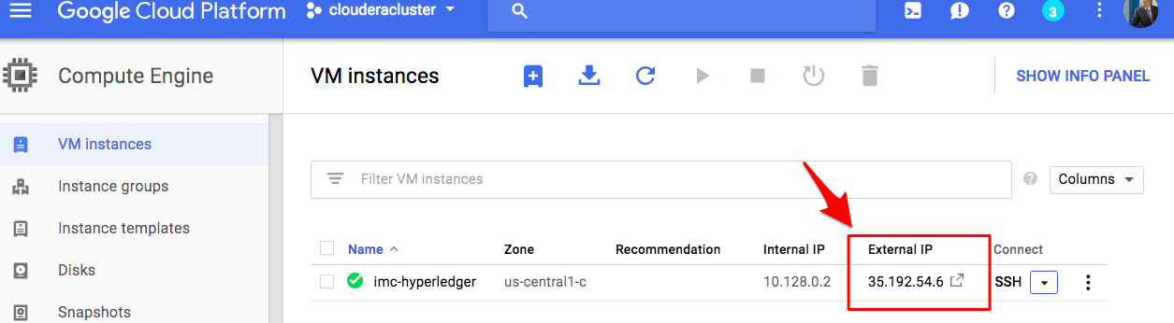
Obtain a server’s external IP
Notes:
11/4/16
‹#›
‹#›

Slide 22
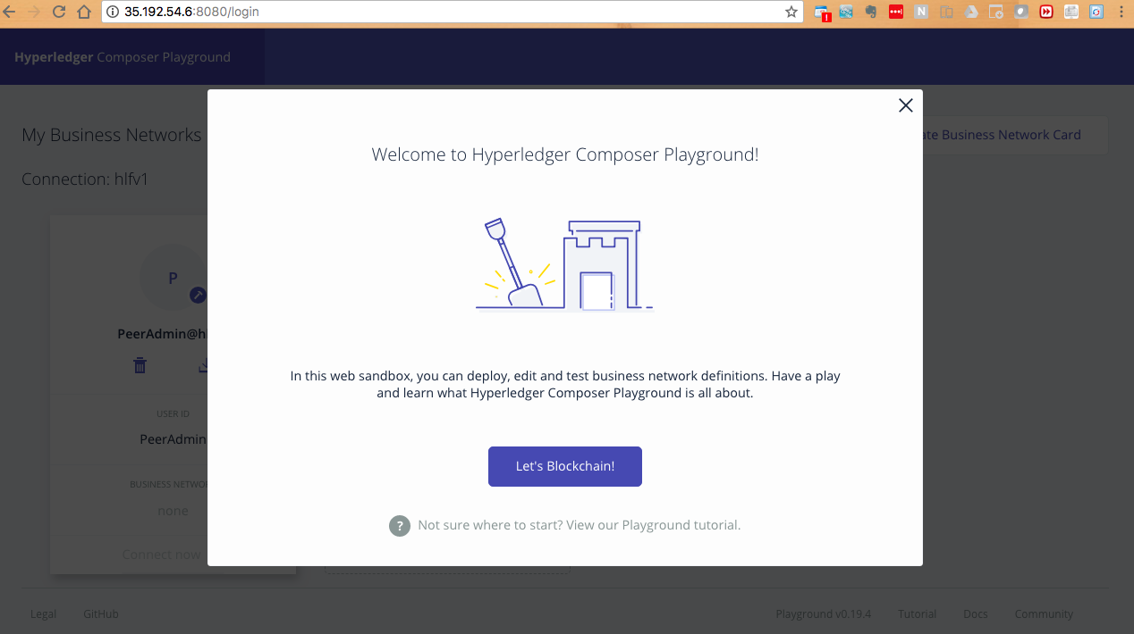
Launch web-playground (http://ip-address:8080)
Notes:
11/4/16
‹#›
‹#›

Slide 23
Running an example business network
Notes:
11/4/16
‹#›
‹#›

Slide 24
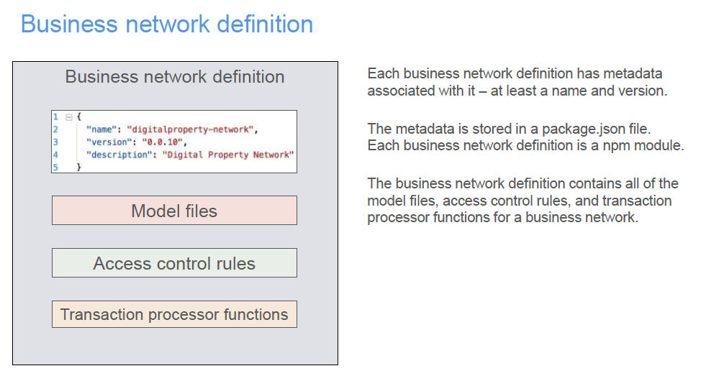

Slide 25
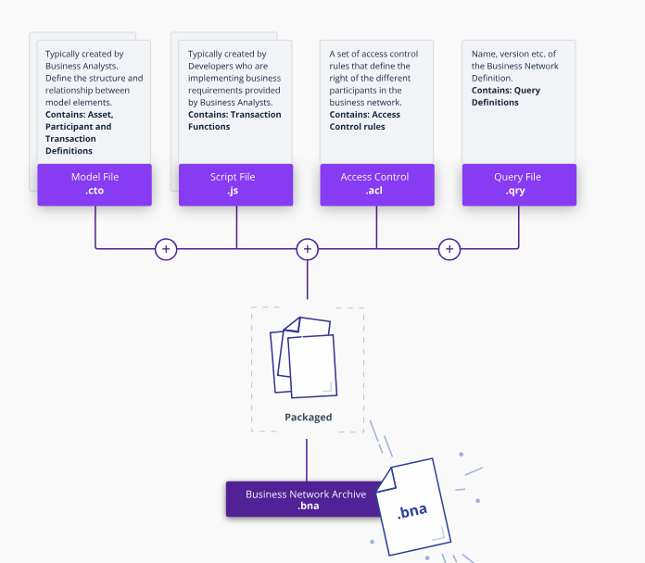

Slide 26
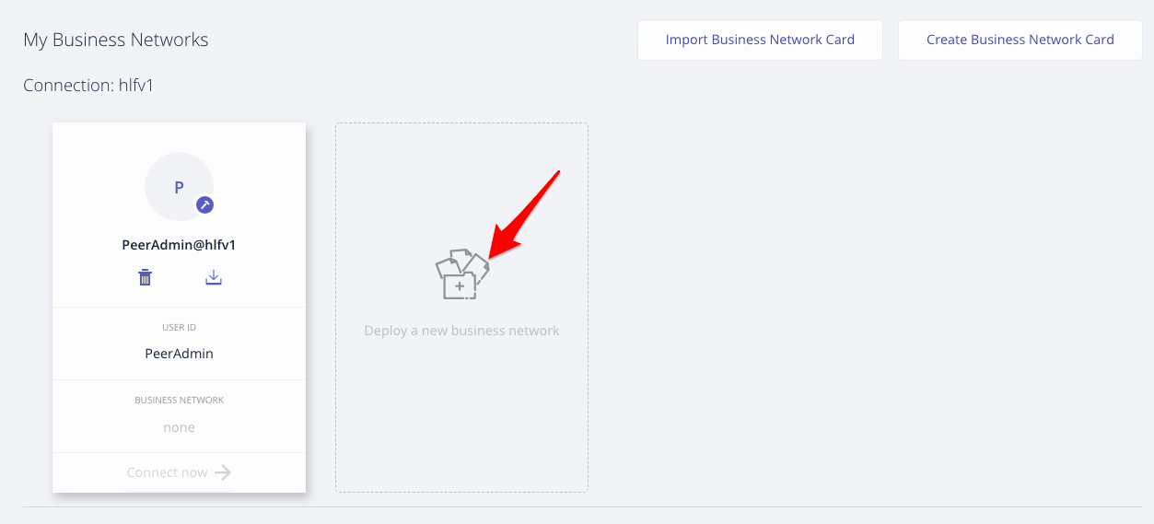
Click Deploy a new business network
Notes:
11/4/16
‹#›
‹#›

Slide 27
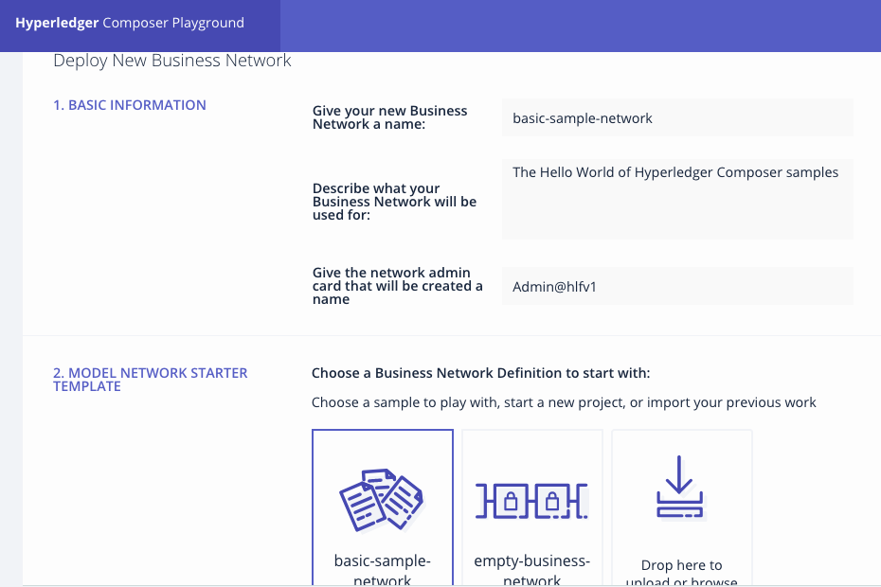
Provide basic information and select basic-sample
-network (provide the network admin as Admin@hlfv1 )
Notes:
11/4/16
‹#›
‹#›

Slide 28
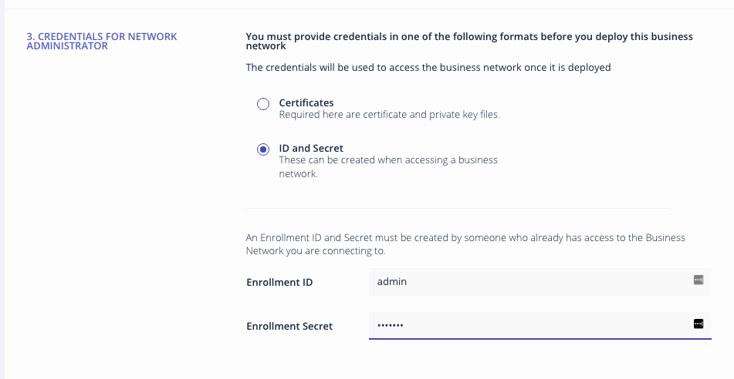
Provide credentials information
(Assign the Enrolment id: admin Enrolment secret : adminpw)
Notes:
11/4/16
‹#›
‹#›

Slide 29
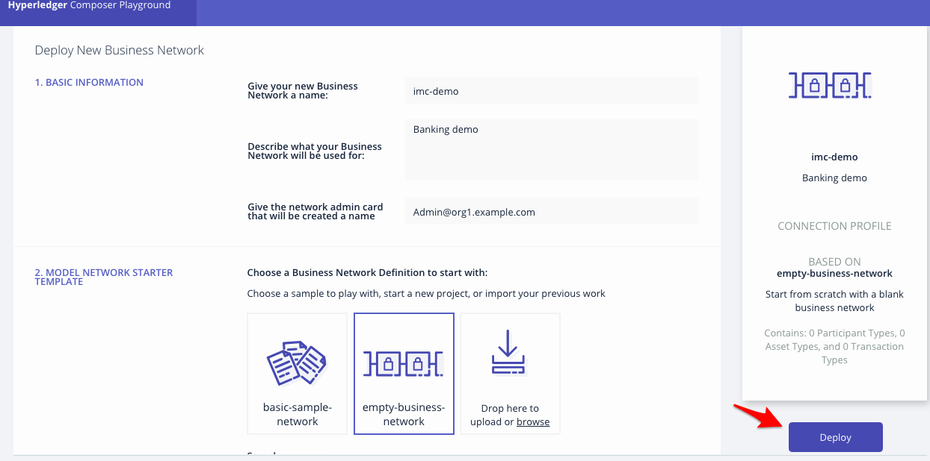
Now the network is defined, click Deploy.
Notes:
11/4/16
‹#›
‹#›

Slide 30
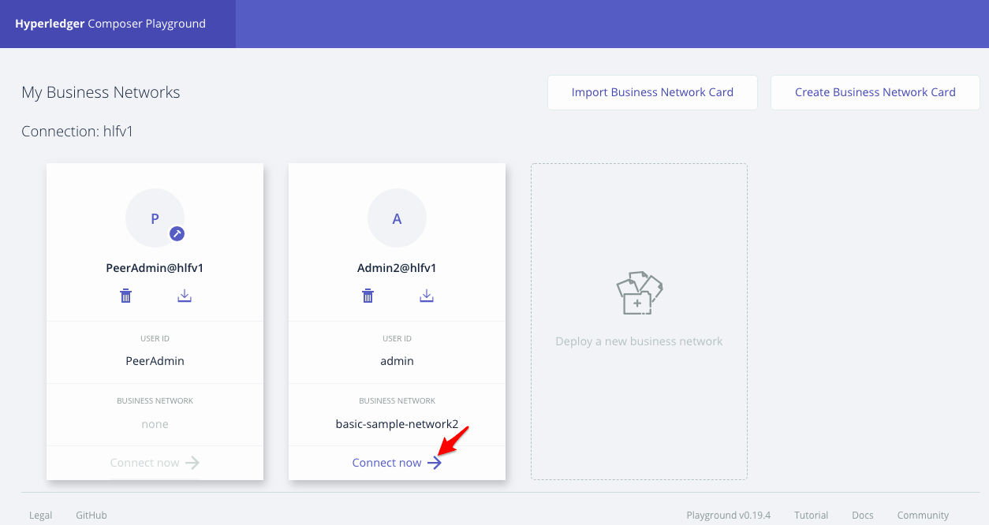
The new business network will be shown,
click Connect now
Notes:
11/4/16
‹#›
‹#›

Slide 31
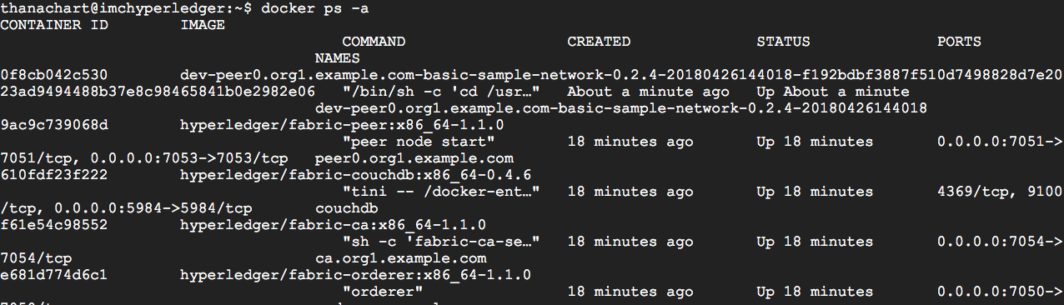
Open another terminal console,
Type command docker ps -a,
You will see another container is running

Slide 32
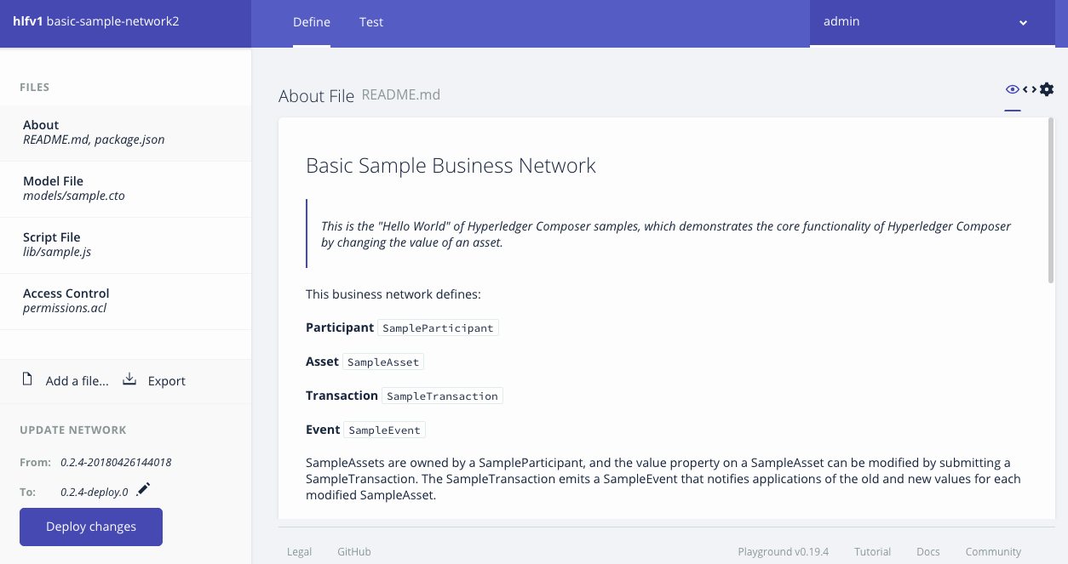

Slide 33
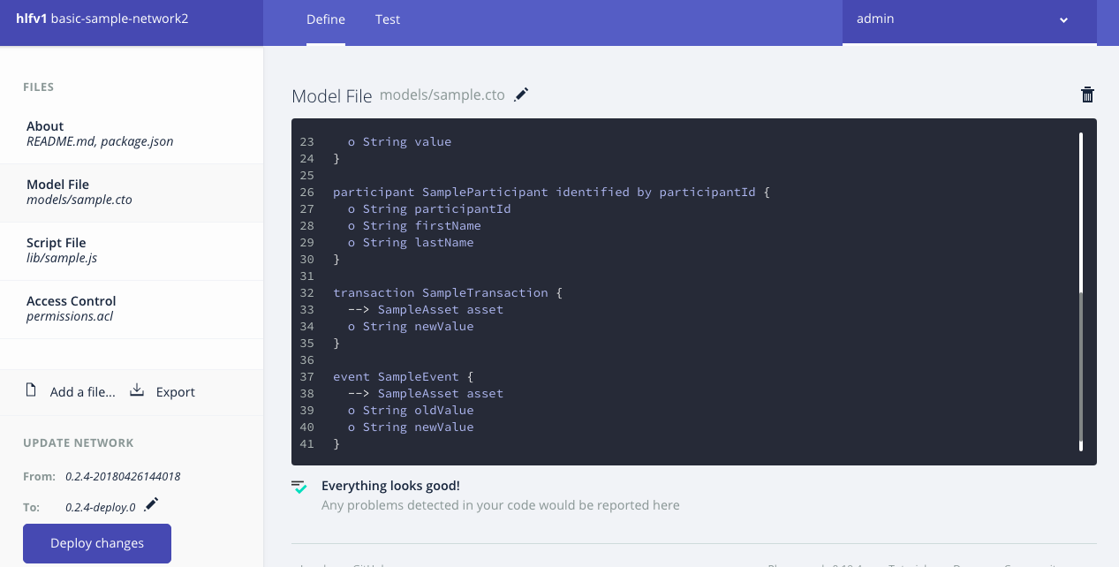
Exploring a business network
Viewing the following files:
Model
Script
Access control

Slide 34
Basic-sample-network
Definition
Asset
SampleAsset
Participant
SampleParticipant
Transaction
SampleTransaction
Event
SampleEvent

Slide 35
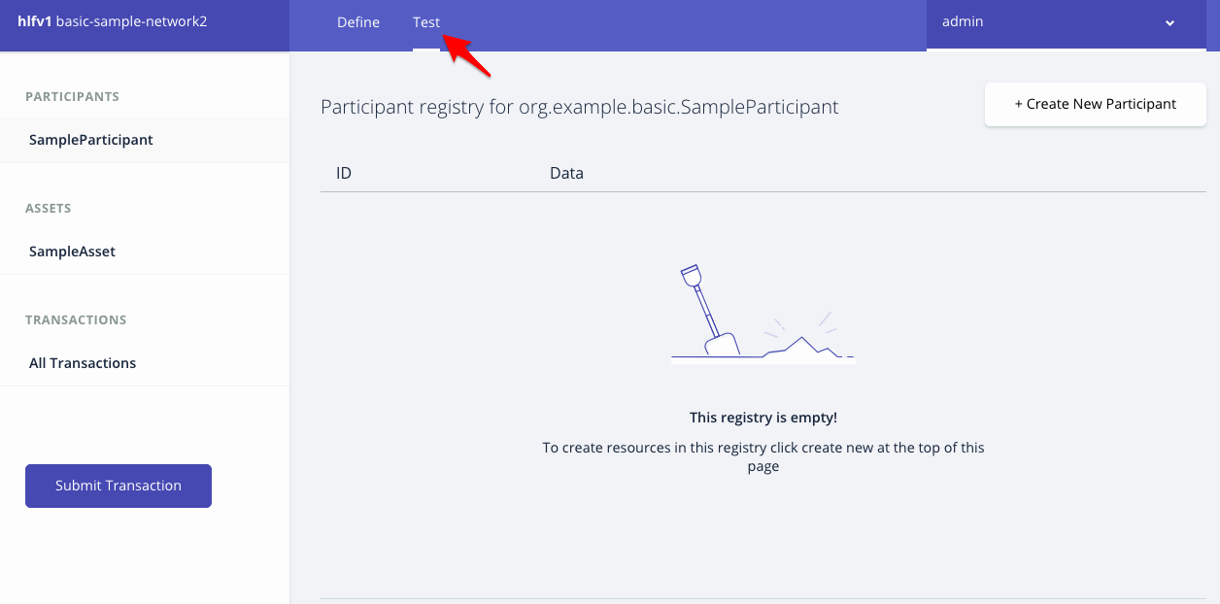
Testing the business network definition,
Click Test tab

Slide 36
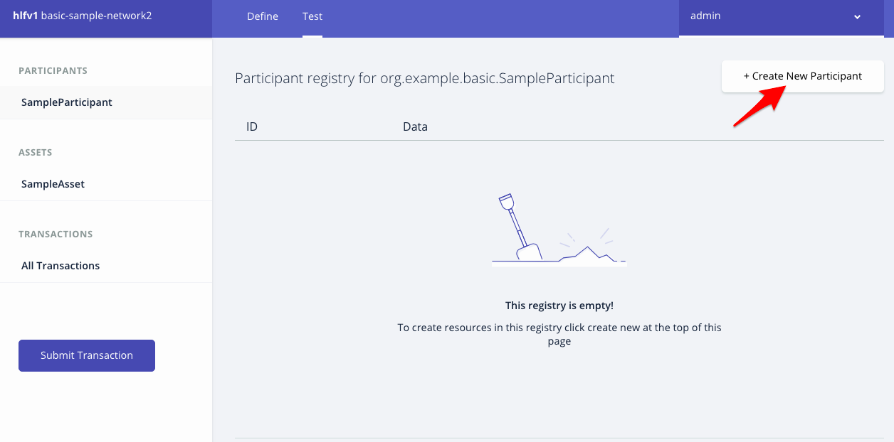
Click Create New Participant

Slide 37
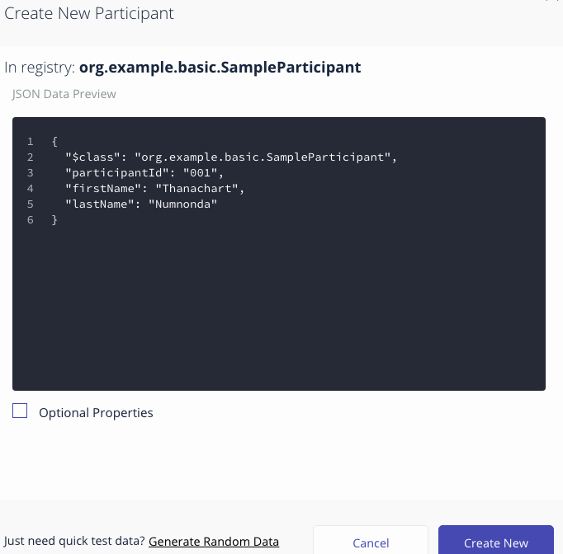
Enter the first participant, the click Create New

Slide 38
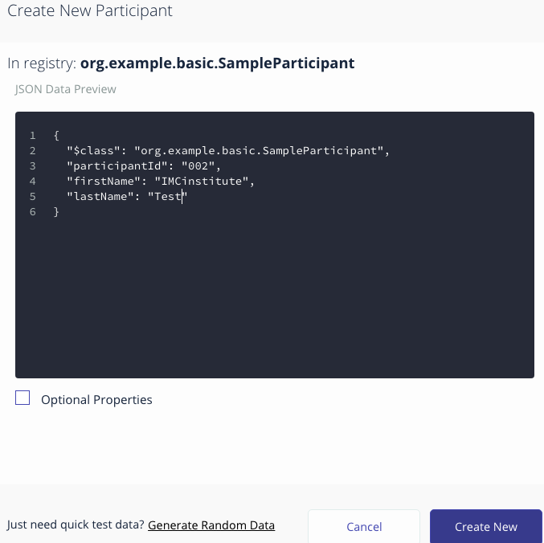
Enter the second participant, the click Create New

Slide 39
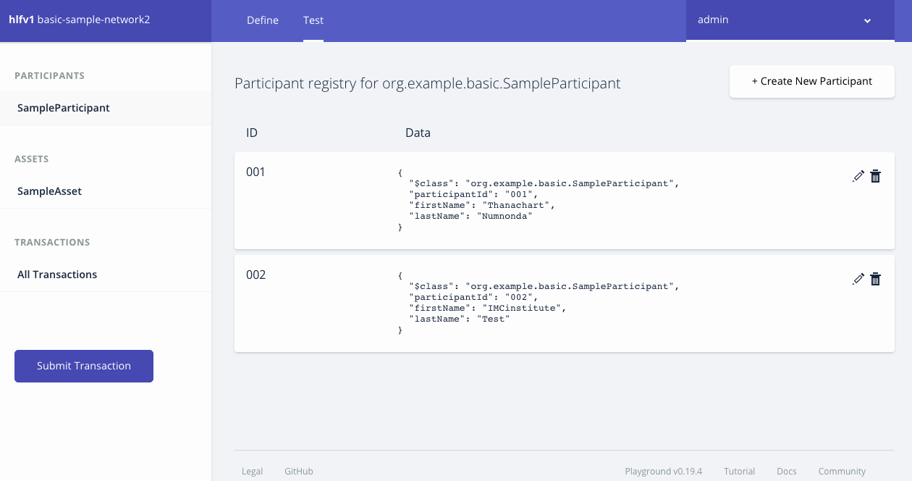
A list of participants will be shown

Slide 40
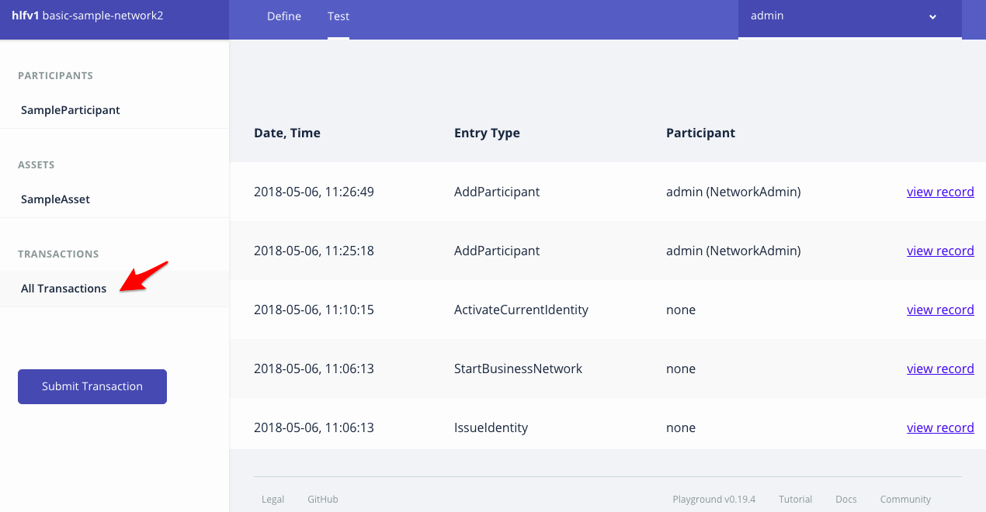
All transactions show events

Slide 41
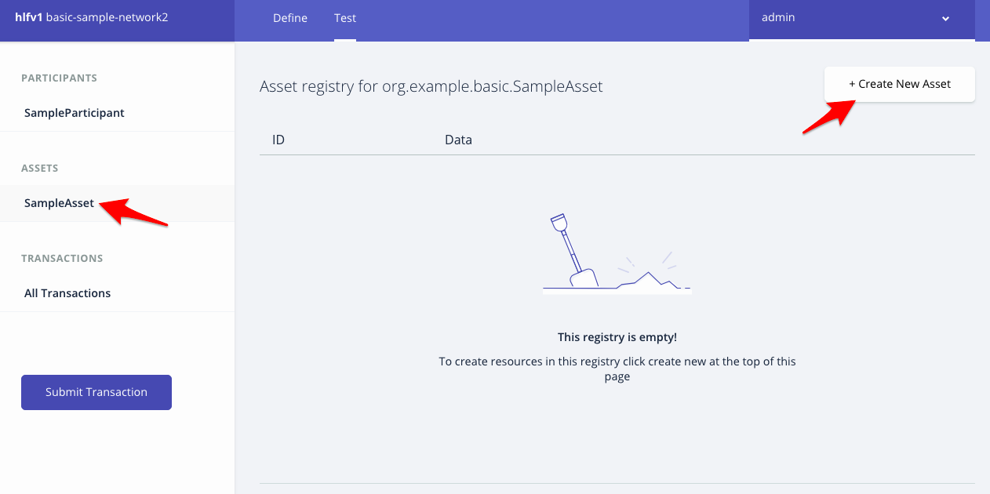
Select SampleAsset, the click Create New Asset

Slide 42
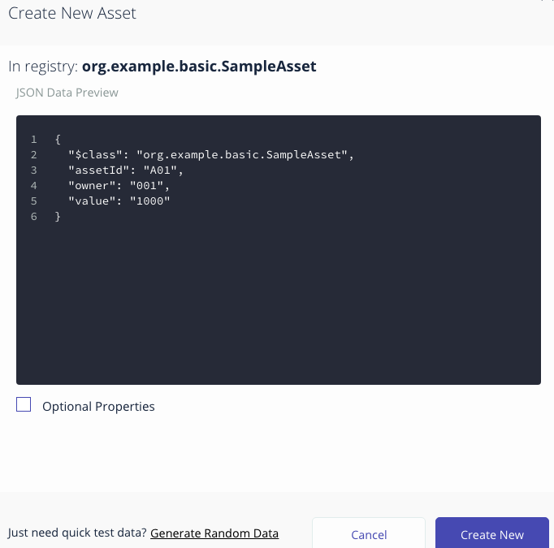
Enter the new asset, the click Create New

Slide 43
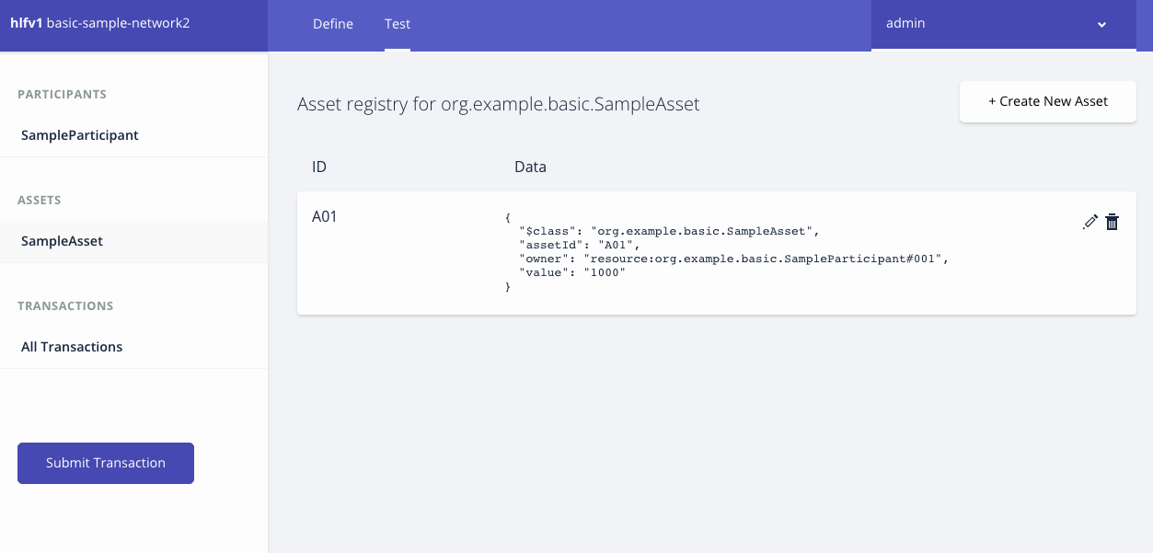
A list of assets will be shown

Slide 44
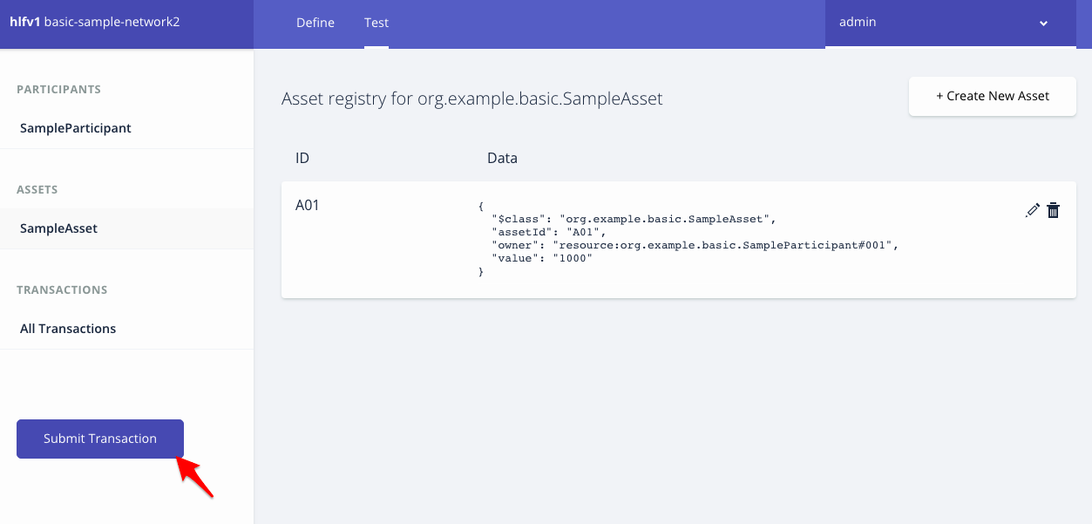
Click Submit Transaction

Slide 45
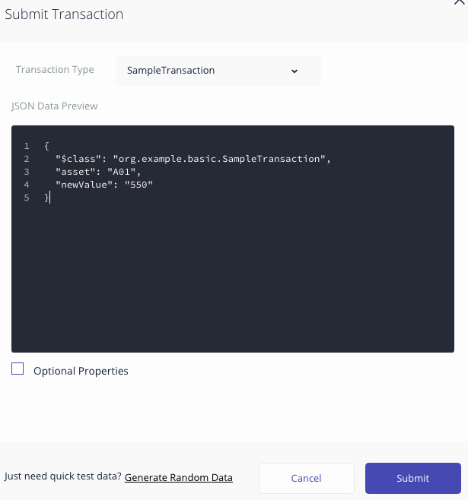
Enter the transaction information, the click Submit

Slide 46
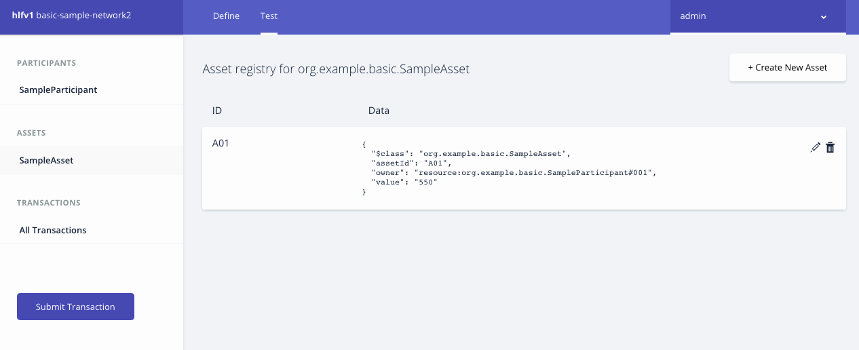
The asset value is now changed

Slide 47
Developing a new business network
Notes:
11/4/16
‹#›
‹#›

Slide 48
my-bank-network
Definition
Asset
Account
Participant
Customer
Transaction
AccountTransfer

Slide 49
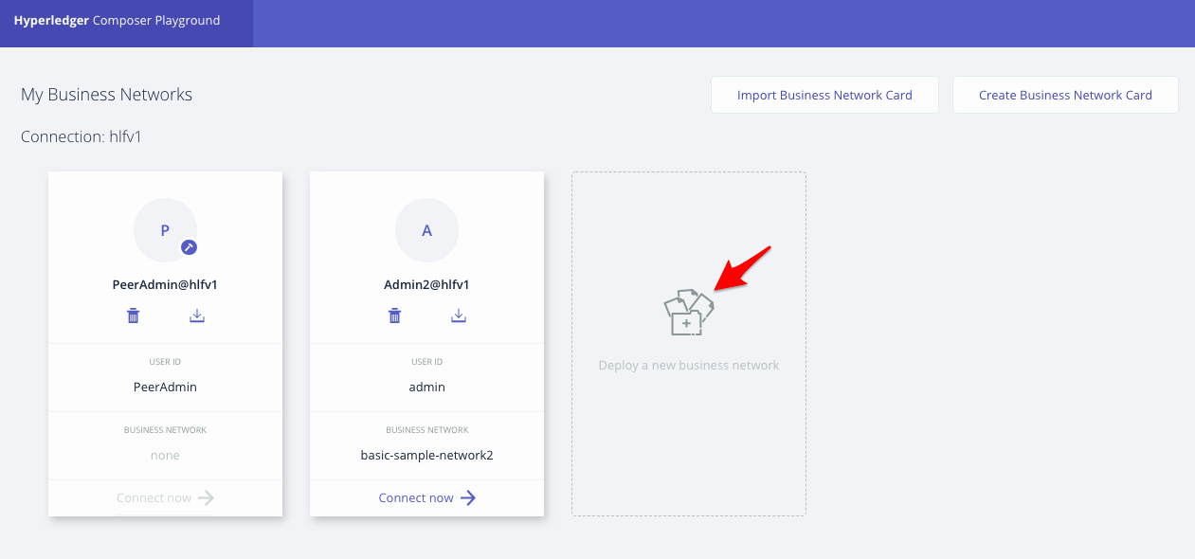
Click Deploy a new business network
Notes:
11/4/16
‹#›
‹#›

Slide 50
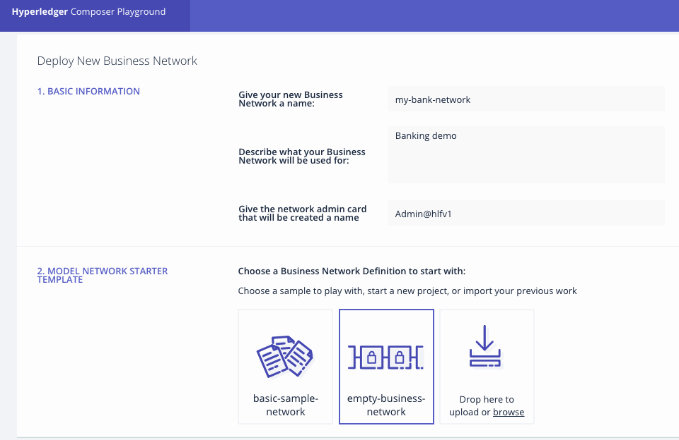
Provide basic information and select empty-business -network (provide the network admin as Admin@hlfv1 )
Notes:
11/4/16
‹#›
‹#›

Slide 51
Provide credentials information
(Assign the Enrolment id: admin Enrolment secret : adminpw)
Notes:
11/4/16
‹#›
‹#›

Slide 52
Now the network is defined, click Deploy.
Notes:
11/4/16
‹#›
‹#›

Slide 53
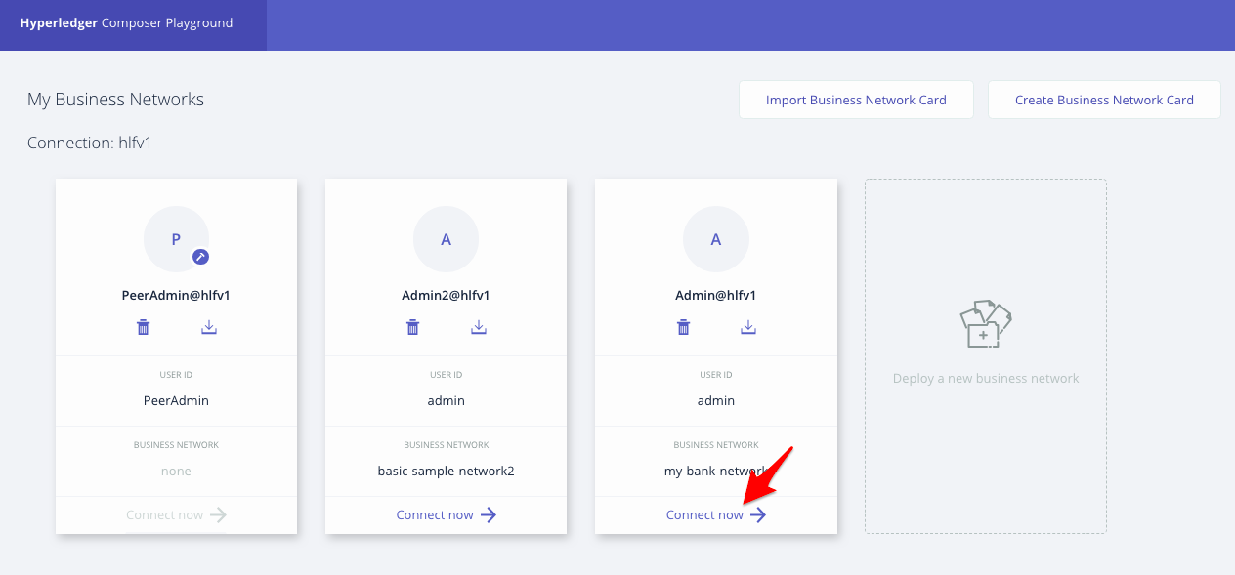
The new business network will be shown,
click Connect now
Notes:
11/4/16
‹#›
‹#›

Slide 54
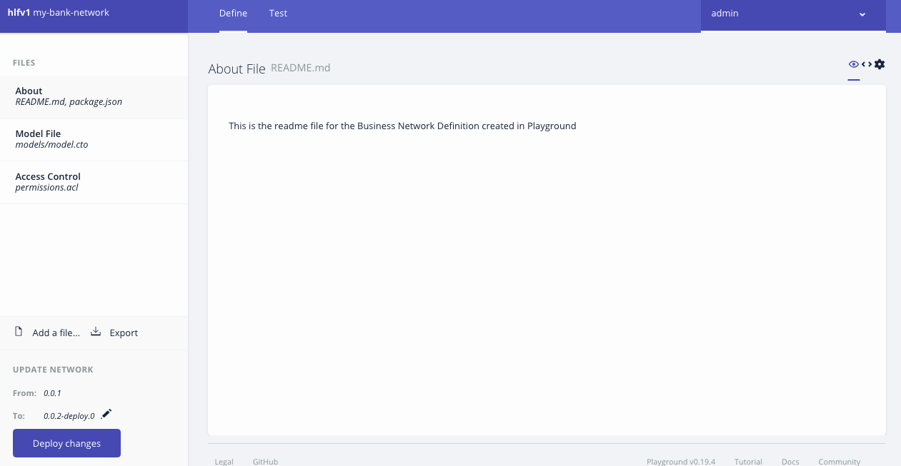

Slide 55
Edit a model file
/**
* Sample business network definition.
*/
namespace org.imc.basic
asset Account identified by accountId {
o String accountId
--> Customer owner
o Double balance
}
participant Customer identified by customerId {
o String customerId
o String firstName
o String lastName
}
transaction AccountTransfer {
--> Account from
--> Account to
o Double amount
}

Slide 56
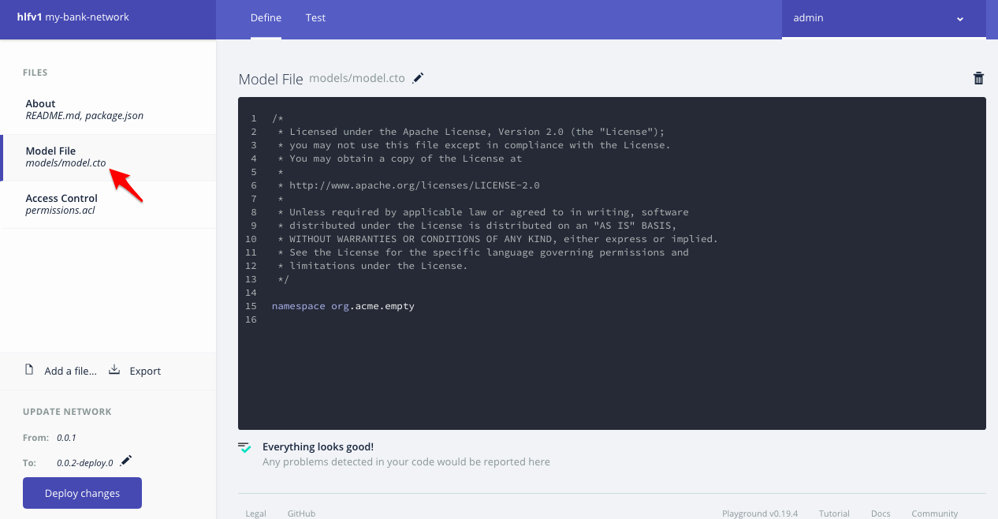
Select Model file, click edit icon

Slide 57
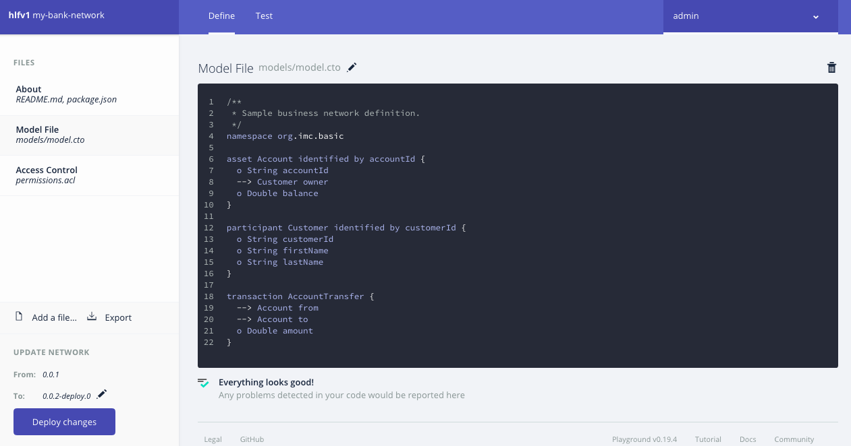

Slide 58
Edit a script file
/**
* Place a transaction for transfering money
* @param {org.imc.basic.AccountTransfer} AccountTransfer
* @transaction
*/
function accountTransfer(accountTransfer) {
if (accountTransfer.from.balance < accountTransfer.amount) {
throw new Error('Insufficient fund');
}
accountTransfer.from.balance -= accountTransfer.amount;
accountTransfer.to.balance += accountTransfer.amount;
return getAssetRegistry('org.imc.basic.Account')
.then(function(assetRegistry) {
return assetRegistry.update(accountTransfer.from);
})

Slide 59
Edit a script file (cont.)
.then(function() {
return getAssetRegistry('org.imc.basic.Account');
})
.then(function(assetRegistry) {
return assetRegistry.update(accountTransfer.to);
});
}

Slide 60
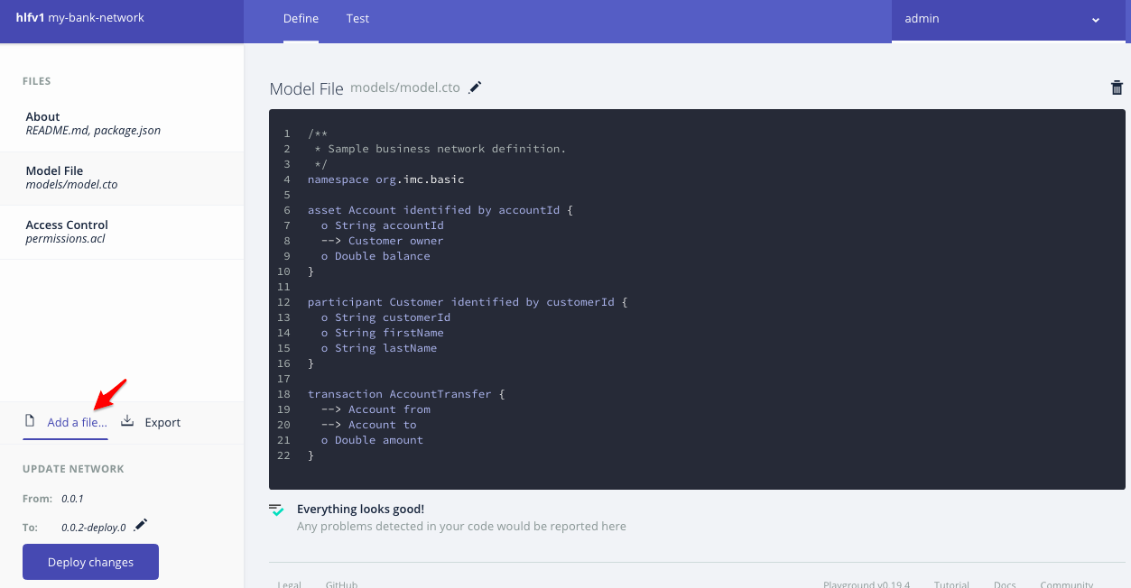
Select Add a file

Slide 61
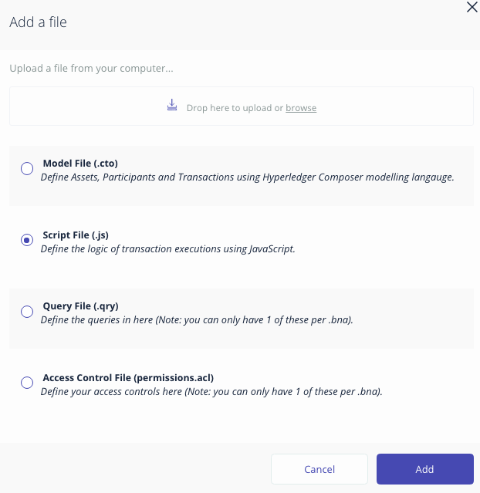
Choose Script File(.js), the click Add

Slide 62
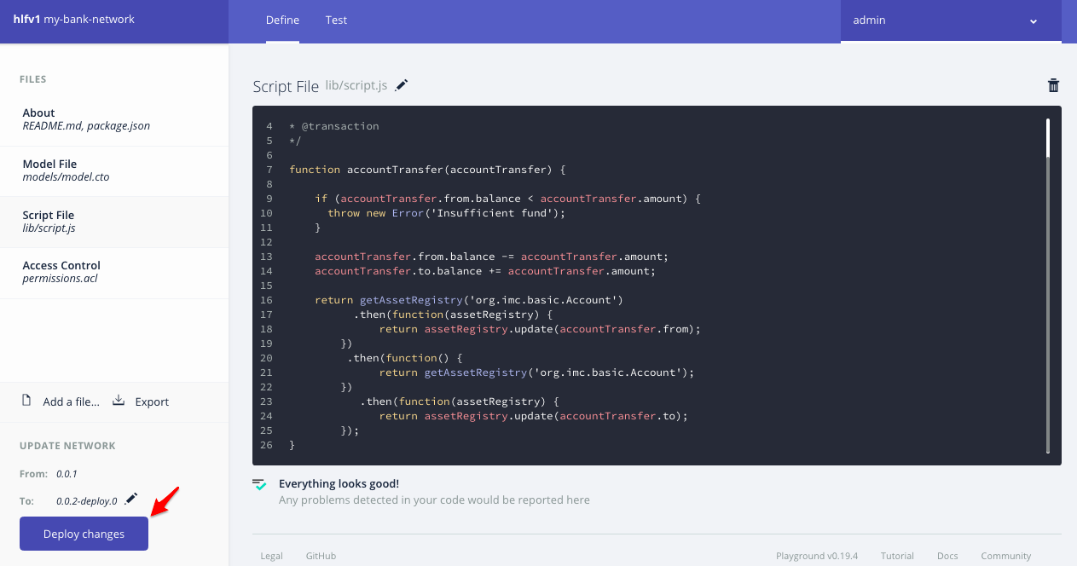
Deploying the updated business network,
Click Deploy change

Slide 63
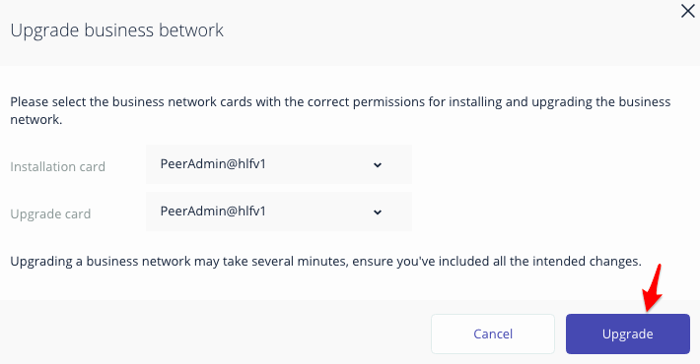
Click Upgrade

Slide 64

Testing the business network definition,
Click Test tab

Slide 65

Click Create New Participant

Slide 66

Enter the first participant, the click Create New

Slide 67

Enter the second participant, the click Create New

Slide 68

A list of participants will be shown

Slide 69

Select Account, the click Create New Asset

Slide 70

Enter the first account, the click Create New

Slide 71

Enter the second account, the click Create New

Slide 72

A list of accounts will be shown

Slide 73

Click Submit Transaction

Slide 74

Enter the transaction information, the click Submit

Slide 75

The account balances are now changed

Slide 76

All transactions show events

Slide 77
Generate REST APIs
Notes:
11/4/16
‹#›
‹#›

Slide 78

List all of the business cards
$ composer card list

Slide 79
Start the REST server & generate the API
$ composer-rest-server
Enter the name of the business network card to use: Admin@hlfv1
Specify if you want namespaces in the generated REST API: never use namespaces
Specify if you want to use an API key to secure the REST API: No
Specify if you want to enable authentication for the REST API using Passport: No
Specify if you want to enable event publication over WebSockets: Yes
Specify if you want to enable TLS security for the REST API: No

Slide 80


Slide 81

Browse REST APIs (http://ip-address:3000/explorer)
Notes:
11/4/16
‹#›
‹#›

Slide 82

Test the REST APIs
Notes:
11/4/16
‹#›
‹#›

Slide 83

Notes:
11/4/16
‹#›
‹#›

Slide 84

Notes:
11/4/16
‹#›
‹#›

Slide 85

Reference: https://hyperledger.github.io/composer/latest/installing/installing-index.html
Notes:
11/4/16
‹#›
‹#›

Slide 86

www.facebook.com/imcinstitute

Slide 87


Slide 88
Thank you www.imcinstitute.com www.facebook.com/imcinstitute

